Slide 1
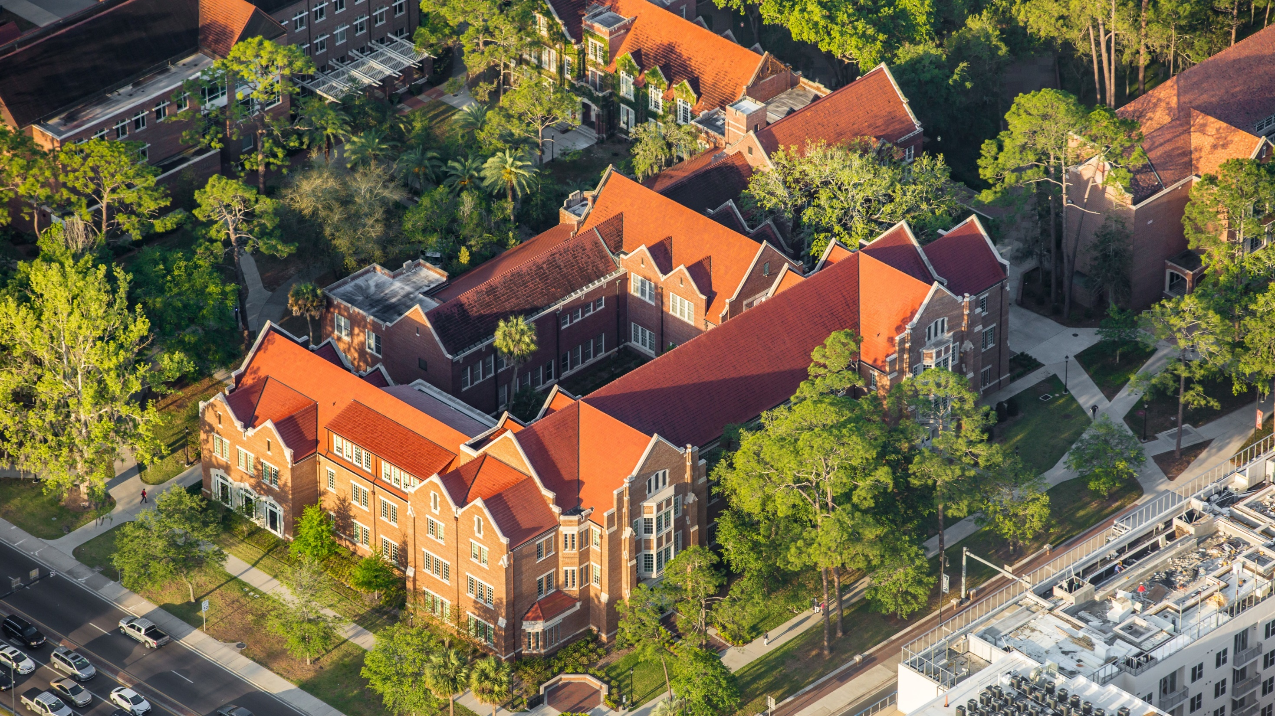
FY21 Year-End
Best Practices
(and deadlines)
University of Florida
CFO Division• Procurement (including PCard)

Slide 2
Critical Dates
Fri May 7
Fri June 18
Wed June 23
Wed July 7
May 7 – Requisitions of $75,000+ only for Appropriated Funds - so there is time to publicly solicit
June 18 – last day to submit requisitions and change orders only for Appropriated Funds – allowing Procurement time to process requisitions, and for cleanup of budget errors
June 23 – last day for PCard vouchers
June 26 - PO’s roll (encumbrances disappear)
July 7 – requisitions on all funds can be entered because appropriated & CYFWD budgets have loaded
Appropriated Funds: 101-109, 111-113, 121-122,
126, 132, 191, 192, 196, 221-222

Slide 3
Importance of Critical Dates
What happens to PO’s starting on 6/26?
  Existing PO encumbrances return to available balance for a few days
  The first distribution line/chartfield completes and a second distribution line with a 7/1/21 budget date is created for the remaining balance
  Budget is loaded, then the rolled PO’s are budget checked and the encumbrances on new funds appear
PCard 6/23:
  You can continue to approve transactions but new vouchers won’t be created until new budgets load on 7/7

Slide 4
Helpful Tips
Ensure you have reconciled your ledgers
Know your available balances and remember that PCard pulls from unencumbered
Use the open encumbrance report to ensure old PO’s are closed (see the Instruction Guide for closing PO’s)
Ensure no PO’s are in budget error – because they won’t roll to the new year
You can’t voucher against a PO which has a change order in-process

Slide 5
Helpful Resources
Reports
Guides
Queries
Enterprise Analytics >
Departmental Reports >
(select your) Department ID>
Open Encumbrance Summary
HR.UFL.EDU >
Financial Toolkits >
myUF Marketplace >
Under Change Orders
“Closing a Purchase Order”
Use this query to enter your PO Business Unit to find POs in Budget Error: UF_PO_BUD_STATUS_E_BY_POBU
Finance & Accounting website “Monthly Financial Reports”

Slide 6
Thank you!
Do you have any questions?
Contracts/requisitions?
Procurement@ufl.edu
(352) 392-1331
“How to” in myUFMarketplace?
myUFMarketplace@ufl.edu
(352) 392-1335
Notes:
List contact information

